Slide 1


ECEN 403 Final Presentation Team 30: Smart Pest Repeller
Andrew Albritton
Melquisedec Ordonez Michael McNeil
Sponsor: Peng Hao Huang

Slide 2
Problem Statement
Many forms of pest control have limitations due to their environmental impacts and costs. The goal of the smart pest repeller is to create a pest control solution that creates the smallest possible footprint on its surrounding environment. By using a machine learning algorithm and ultrasonic emitters, the smart pest repeller addresses the problem of pest control while minimizing it’s impact on its surroundings.

Slide 3
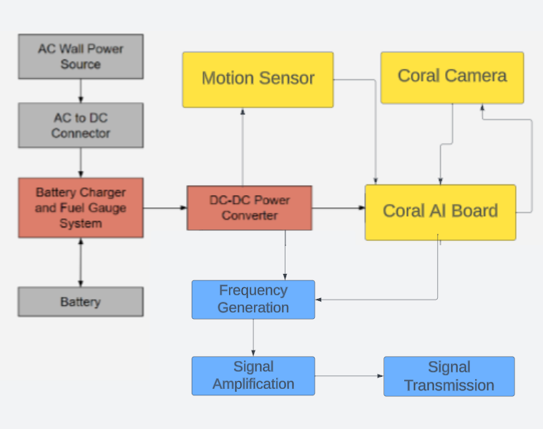
System Block Diagram:
Andrew Albritton: Yellow (ML Algorithm / Emitter Control)
Michael McNeil: Red / Grey (Power Delivery / Battery Charging)
Melquisedec Ordonez: Blue (Emitter Subsystem)

Slide 4
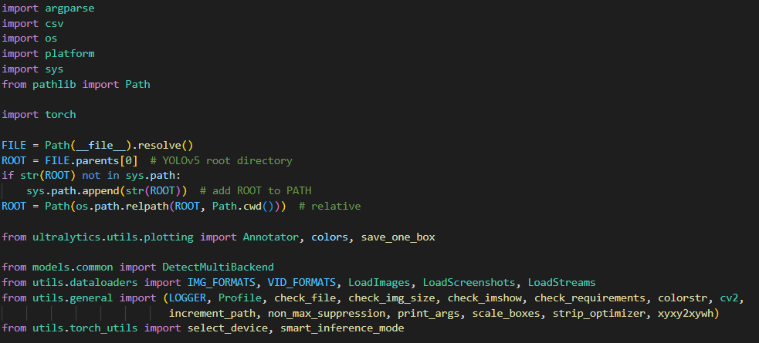
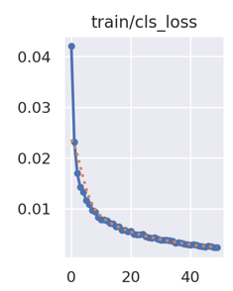
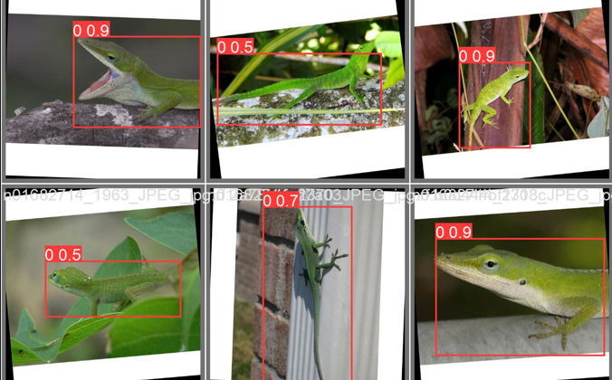
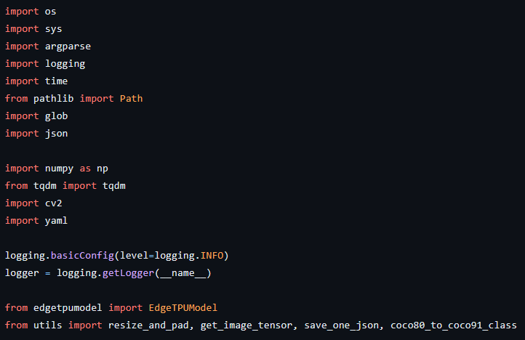
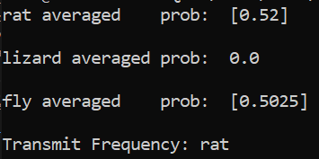
Machine Learning Subsystem
Hours: 73
Training set built containing over 9000 images and 11 classes labeled
YOLOv5 image model Trained to a loss > .1
Detection Testing with PyTorch function
Model converted from PyTorch to Tensor Flow LITE (int - 8)
Detection function written in PyTorch converted to minimal function only using PyCoral for Edge TPU compatibility.
Detection Testing with TensorFlow LITE compatible function
Detection data processing function completed

Slide 5
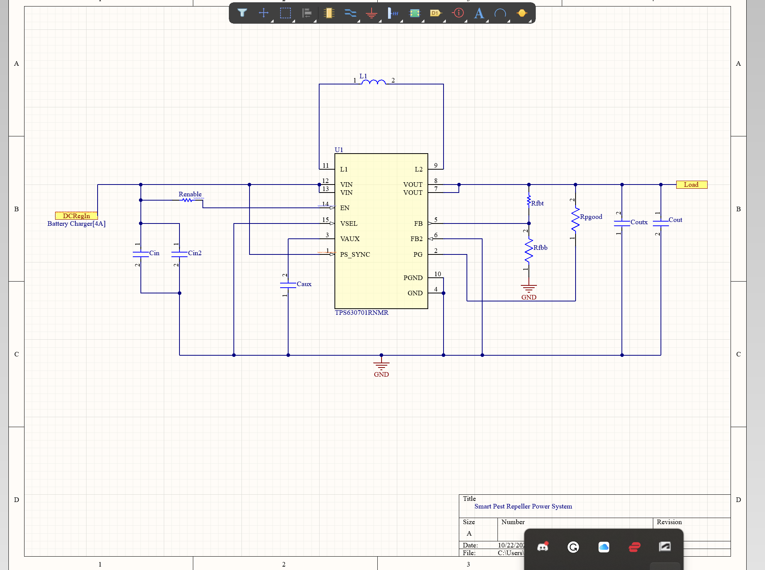
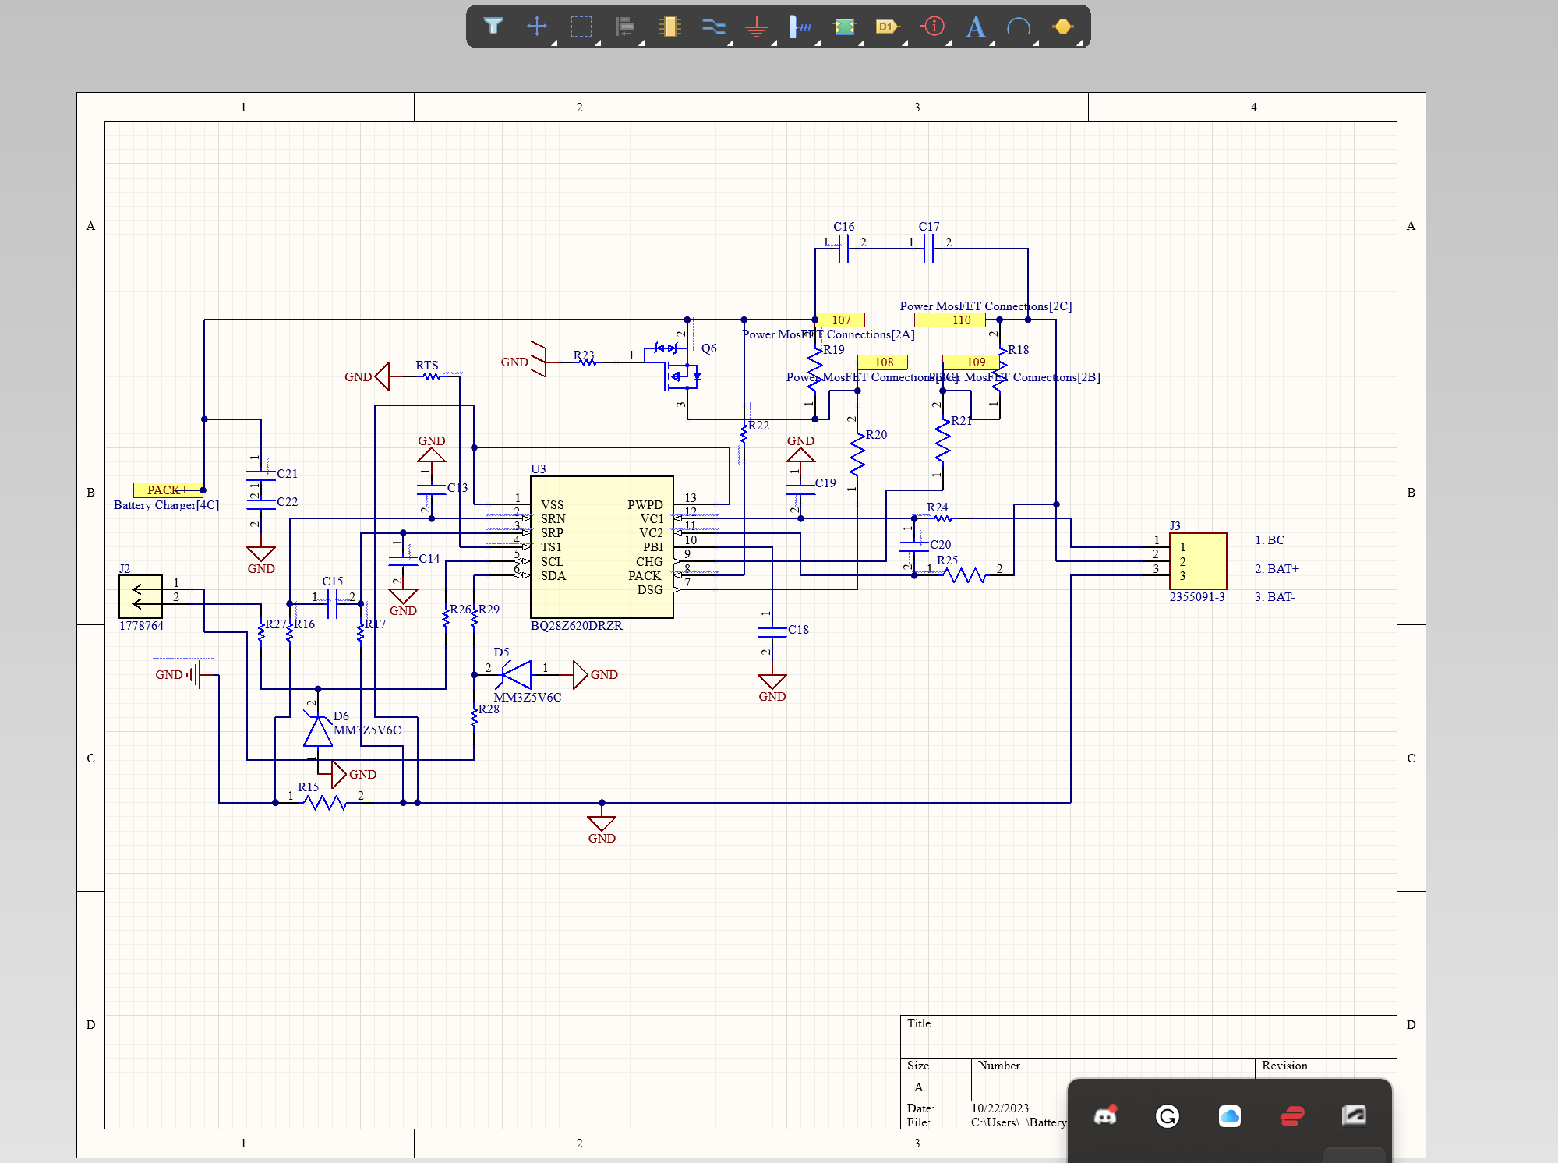
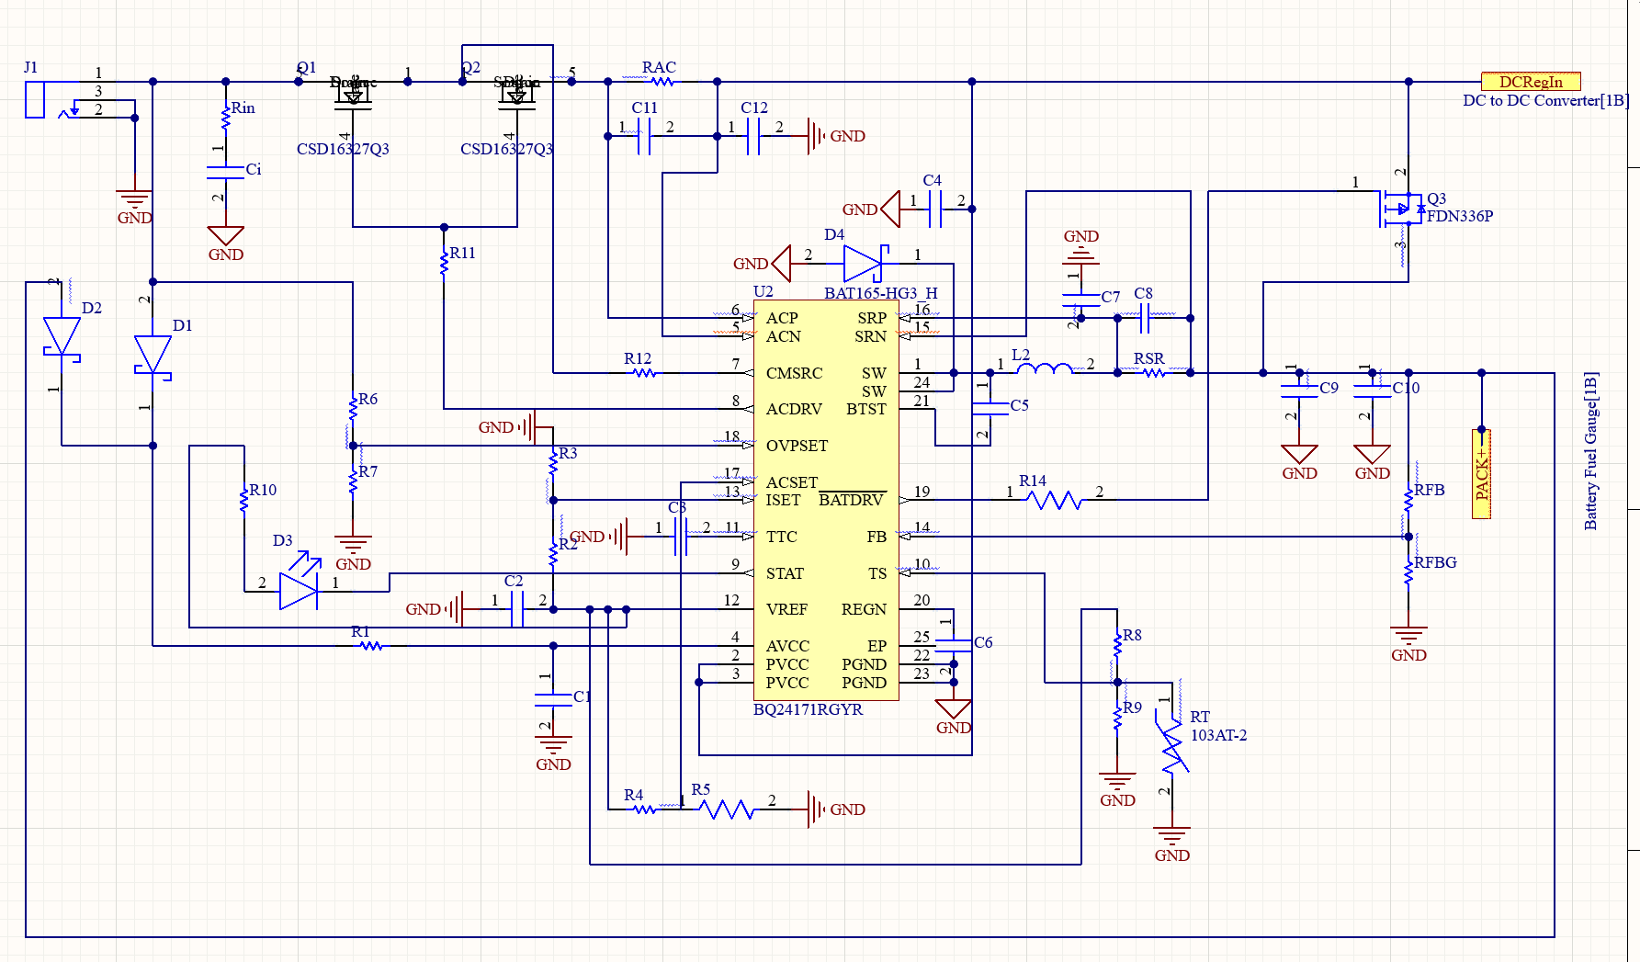
Power Subsystem
Hours: 50
Parts research and selection
Designed battery charger schematic for 2S2P 7.2V battery power source
Designed a battery fuel gauge schematic for a 2S battery
Designed a DC/DC voltage regulator schematic for outputting a 5V 2A signal

Slide 6
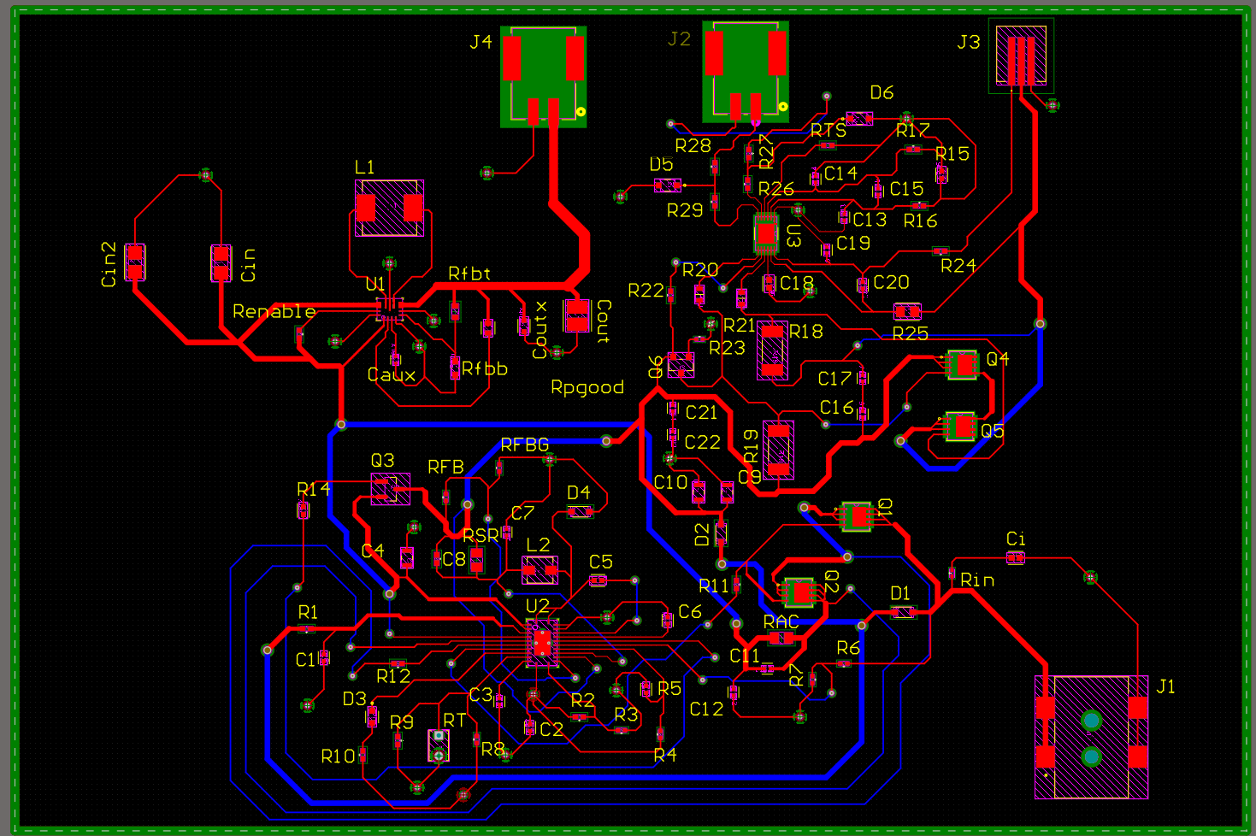
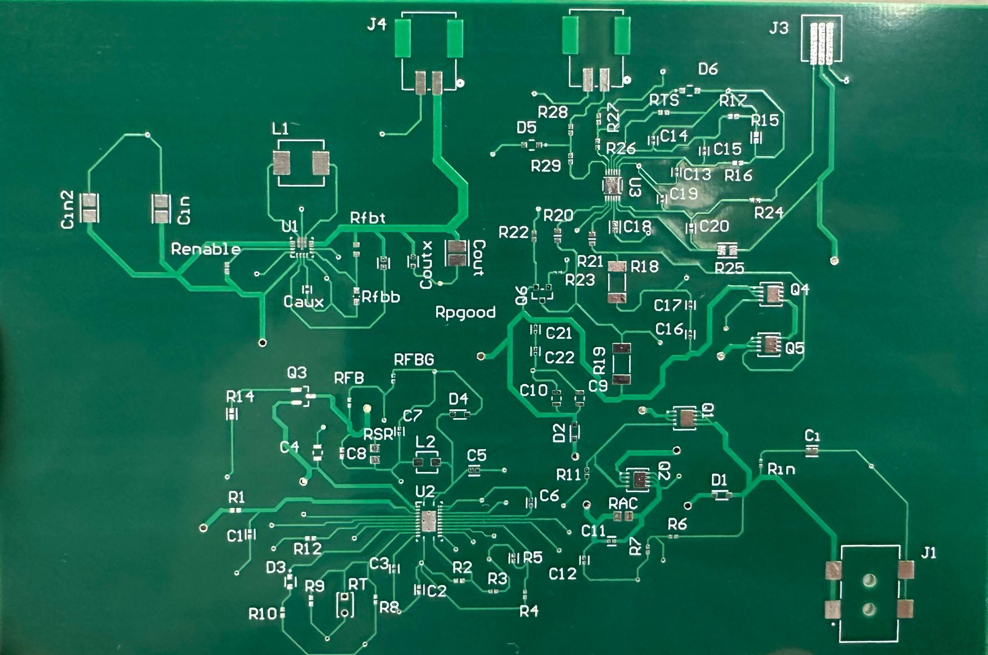
Power Subsystem
Placed and routed PCB components
Conducted a design review of PCB
Started PCB assembly

Slide 7
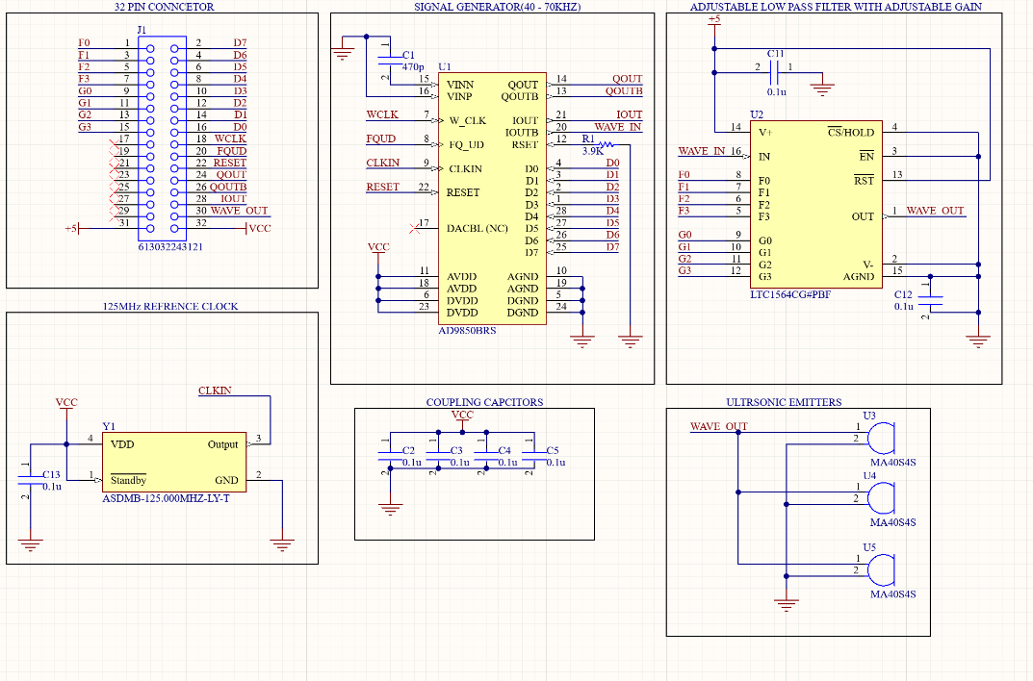
Signal Generator Subsystem
Hours: 45
Designed signal generator based on ad9850brs to output up to 70 Khz signal
Implemented adjustable filter to reduce any unwanted signal frequency and amplify output signal from ad9850 (also adjustable)

Slide 8
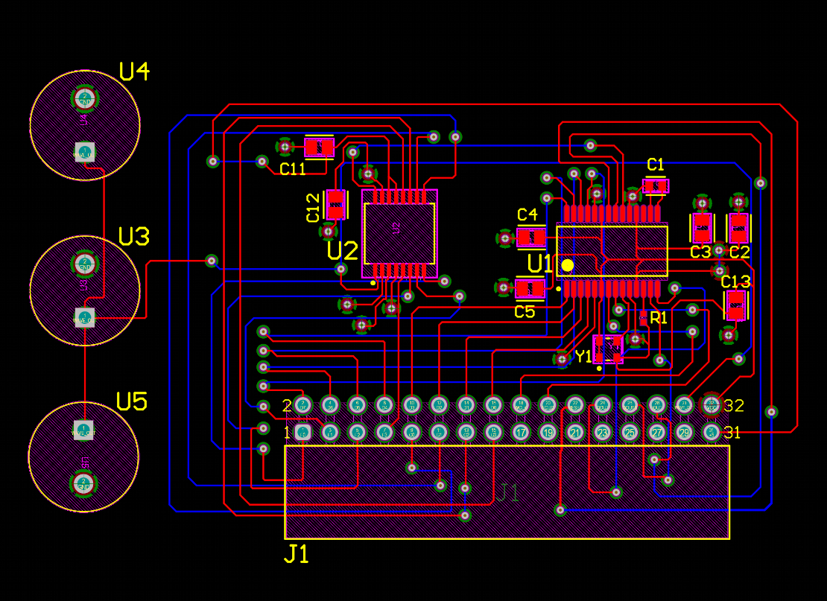
Signal Generator Subsystem
PCB design completed and part ordered (not yet delivered)
All components ordered(2 parts not delivered yet)

Slide 9
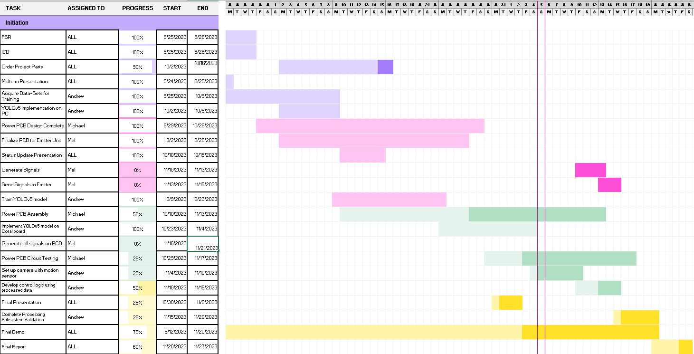

Slide 10
Task | Paragraph (FSR) | Specification | Result | Owner
Training Verification | 3.2.1.2 | Goal of 90%>= precision or Goal of .1 >= loss | PASS | Andrew
Camera Verification | 3.2.1.3 | make sure 3 photos are taken per second |  | Andrew
Motion Verification | 3.2.3.1 | Ensure camera activates from motion control |  | Andrew
Camera MLA processing verification | 3.2.5.1.1 3.2.5.1.2 | Ensure precision is maintained post- implementation (Generalization of model usually yields 10-30% lower probability of detection) |  | Andrew
GPIO signal transmission verification | 3.2.3.2.1 | Ensure signal transmitted from GPIO pins matches detected organism |  | Andrew
DC/DC Voltage Converter Verification (3.2.1.3.3) | 3.2.1.3.3 | Verify that converter can take in various input voltages and continue to output 5V and 2A |  | Michael
Battery Charger Verification (3.2.1.3.4) | 3.2.1.3.4 | Verify battery charger charges battery |  | Michael
Fuel Gauge Indicator Verification | 3.2.1.3.5 | Verify fuel gauge tracks fuel and indicates when batteries need to charge |  | Michael
Power PCB Verification | 3.2.1.3.6 | Verify PCB circuit connects and system functions as intended |  | Michael
Signal Verification | 3.2.1.1 3.2.3.2.1 | Establish signal generator can produce the three separate frequencies required |  | Mel
Amplifier Verification | 3.2.1.1 | Verify signal is appropriately amplified before reaching emitter |  | Mel
Emitter verification | 3.2.1.1 3.2.3.2.1 | Make sure emitter can emit required frequencies |  | Mel
Emitter PCB verification | 3.2.1.1 | Verify circuit behaves like individually verified componentes did |  | Mel

Slide 11
403 Remaining Tasks
Power PCB Assembly and Testing
Write GPIO control function (motion-sensor / data transmission)
Write camera control function / camera detection validation
Coral board Path management
Receive Signal generator PCB. Assemble PCB and validate functionality.

Slide 12
404 Future Tasks
Housing Unit design and fabrication
Power interconnections
Signal generation communication
Full system integration

